Slide 1
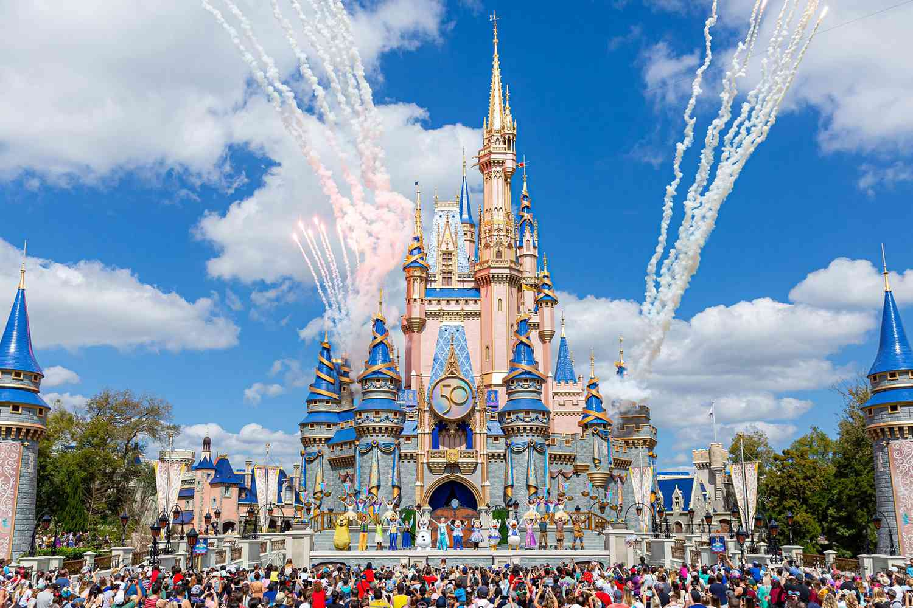
Data Science @ Disney World
Tim
Hellemans

Slide 2

The data

Slide 3
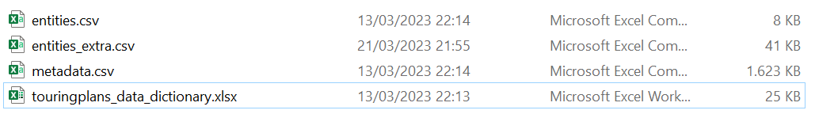
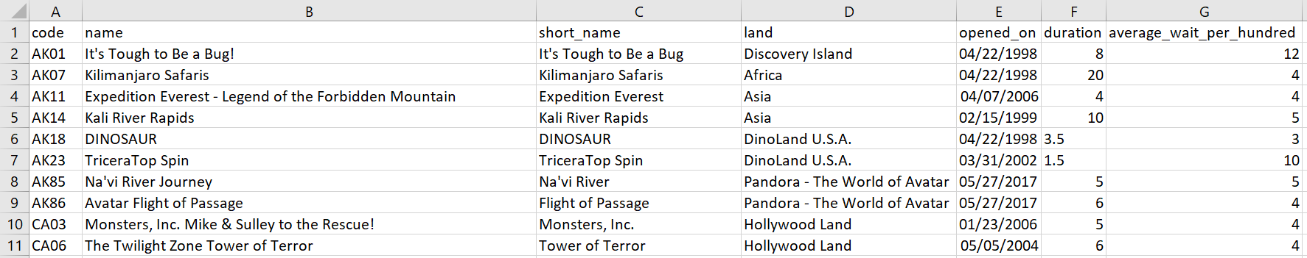
Getting to know the data
Some information on each attraction

Slide 4
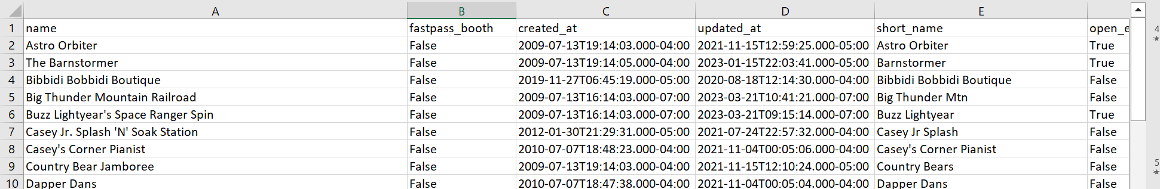
Getting to know the data
Extended version of entities.csv

Slide 5
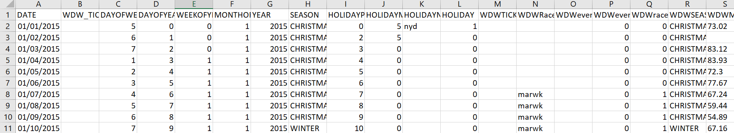
Getting to know the data
Data about each day

Slide 6
Getting to know the data
Locations of files

Slide 7
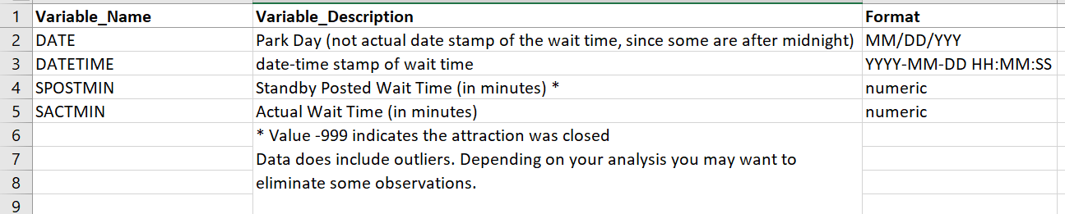
Getting to know the data
Information about the data

Slide 8
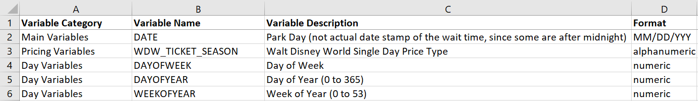
Getting to know the data
Information about the data

Slide 9
Getting to know the data
Information about the data

Slide 10
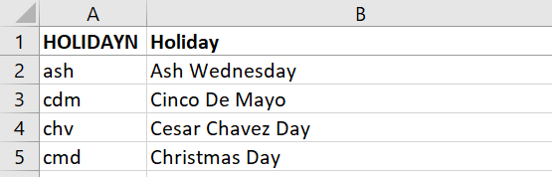
Getting to know the data
Information on holidays

Slide 11
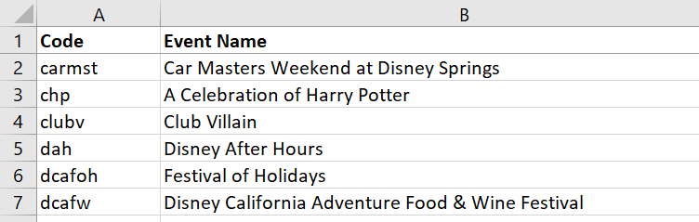
Getting to know the data
Information on events

Slide 12
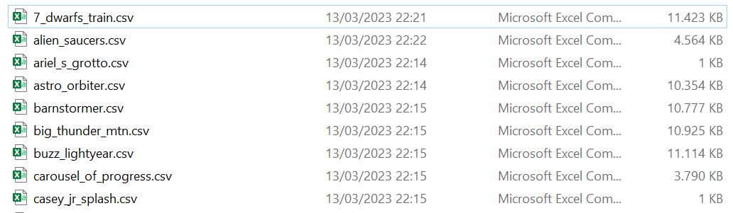
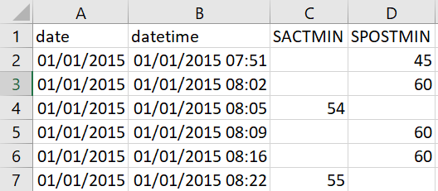
Getting to know the data: Waiting times

